Slide 1

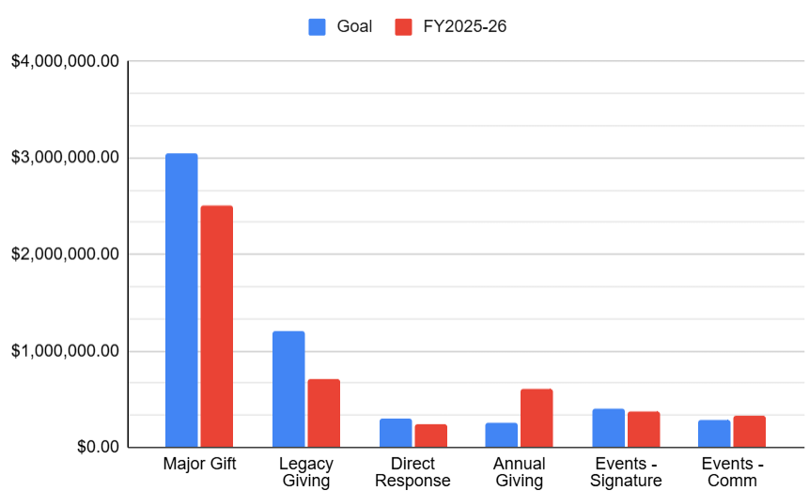
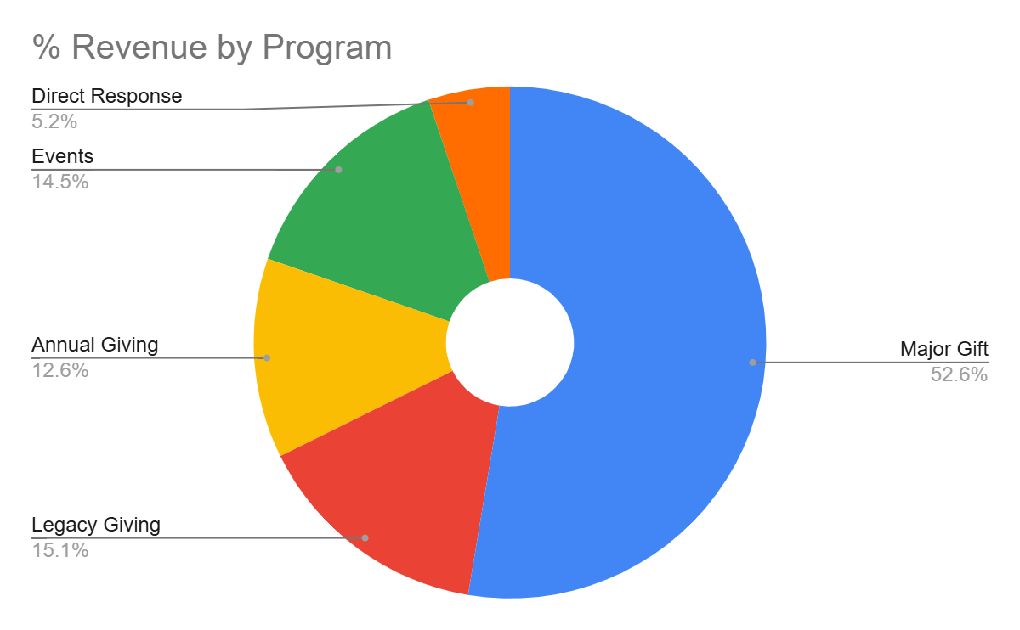
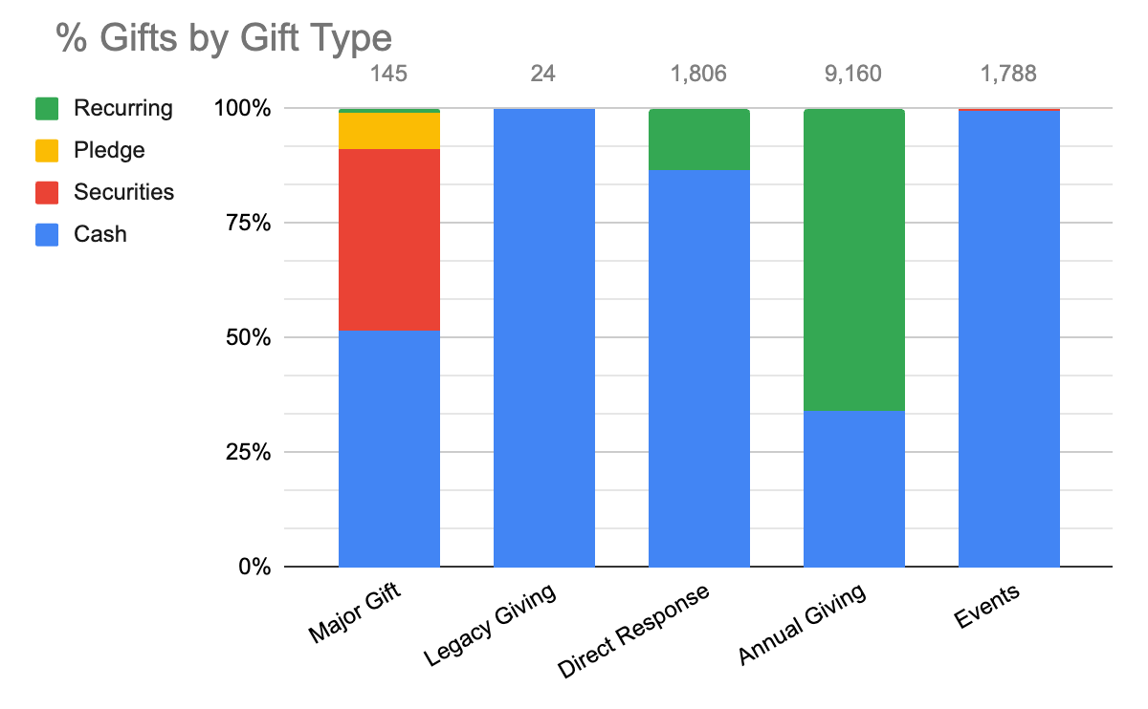
PHILANTHROPY PROGRAM REPORT FY 2025-26
CONFIDENTIAL
GOAL $5,962,927
$ Gifts $5,492,393 # Gifts 13,720
% Goal 92%
5 year comparison | 2021-22 | 2022-23 | 2023-24 | 2024-25 | 2025-2026
Total Giving | $4,263,340 | $3,975,122 | $4,039,676 | $4,407,016 | $5,492,393
# of Gifts | 15,995 | 16,596 | 12,816 | 14,734 | 13,720
# Donors | 6,201 | 7,796 | 5,363 | 7,049 | 5,703
Prepared by: Shelley Graham - Sr. Director, Philanthropy 04/09/26

Slide 2
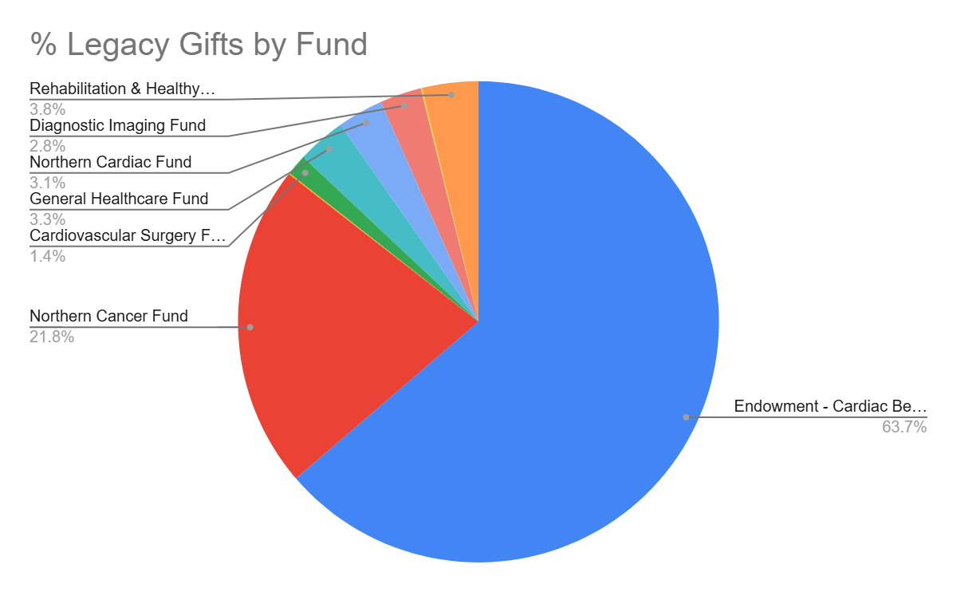
Legacy Giving FY 2025-26
CONFIDENTIAL
Annual Goal $1,200,000
Total Gifts $715, 704
Variance $484, 296
% Goal 60%
Revenue shortfall reflects delayed realization of two estate gifts, both now anticipated in 2026-27
3 year average $810,619 5 year average $604,284
Open Estates 14
New Expectancies 13
Total Expectancies 77
FY Average Gift $27,527 Limetime Average Gift $75,000
Q4 Highlights: -Proactive Estate Administration
-Expanded Outreach
-Community Engagement 55+ Health & Wellness Fair Alterna/Erikson Presentation
-Operational Planning
2026-27 Q1 Priorities: -Attend CAGP Conference
-Love & Loyalty - Easter cards (52)
-Increase intentional solicitations
-Awareness Campaign for May (Leave a Legacy month):
-Multi channel comms plan
-Legacy newsletter (1,500)
-Virtual presentation (NOSM)

Slide 3

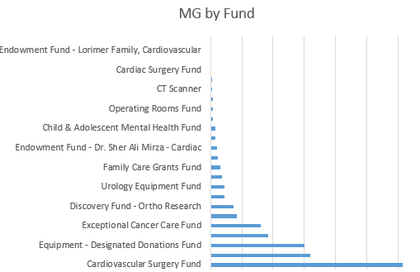
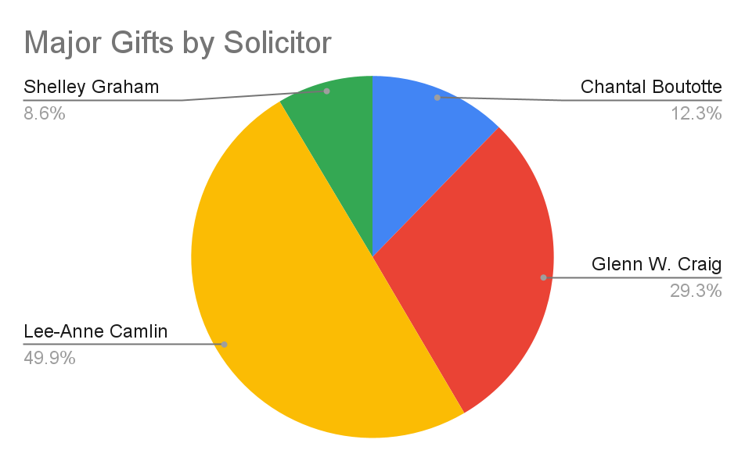
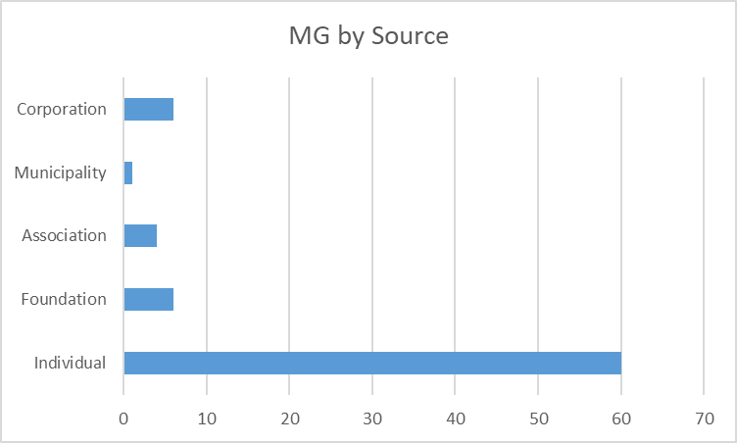
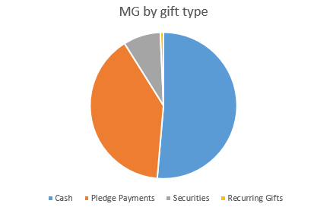
Major Gifts FY 2025-26
GOAL $3,041,000
Total Gifts $2,500,215
% Goal 82%
# Pledged Gifts 2
$ Pledged Gifts $35,000
# Gifts Received 134
$ Gifts Received $2,465,215
# New MG Donors 9
Q4 Highlights: -Wrap Up of Women in Action
-Transition from Campaign based to Donor Centric fundraising
-Stewardship of OHAH donors
-Cross program support, leveraging MG’s
2026-27 Q1 Priorities: -Increase qualified solicitations
-Secure 2 new MG donors
-Increase attendance at community networking events
-Constantly moving donors through donor cycle (moves management)

Slide 4
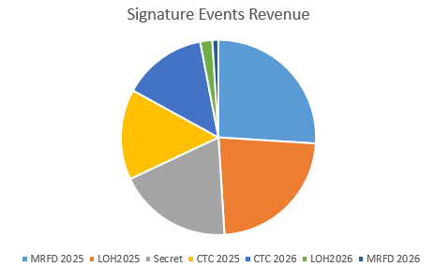
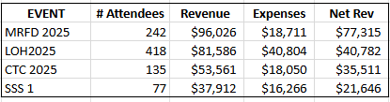
Events FY 2025-26
CONFIDENTIAL
GOAL $686,300
Total Raised $690,834
% Goal 101%
Sig. Events Goal $399,300
Sig. Events $367,016
# Sig. Events 4
Comm. Events Goal $286,900
Comm. Events $323,818
# Comm Events 50
# New Comm Events 13
Q4 Highlights: -Staff at full complement
-Inaugural SSS high potential for growth
-OnceCause streamlining workflows and event admin efficiencies
-Increase in Comm events
-Cross departmental strategies
2026-27 Q1 Priorities: -CTC - April 16th
-increased sponsorship
-high value prizes
-increase ticket sales
-MRFD - ongoing planning
-LOH - secure speaker (Kim MacDonald)
- recruit committee members

Slide 5
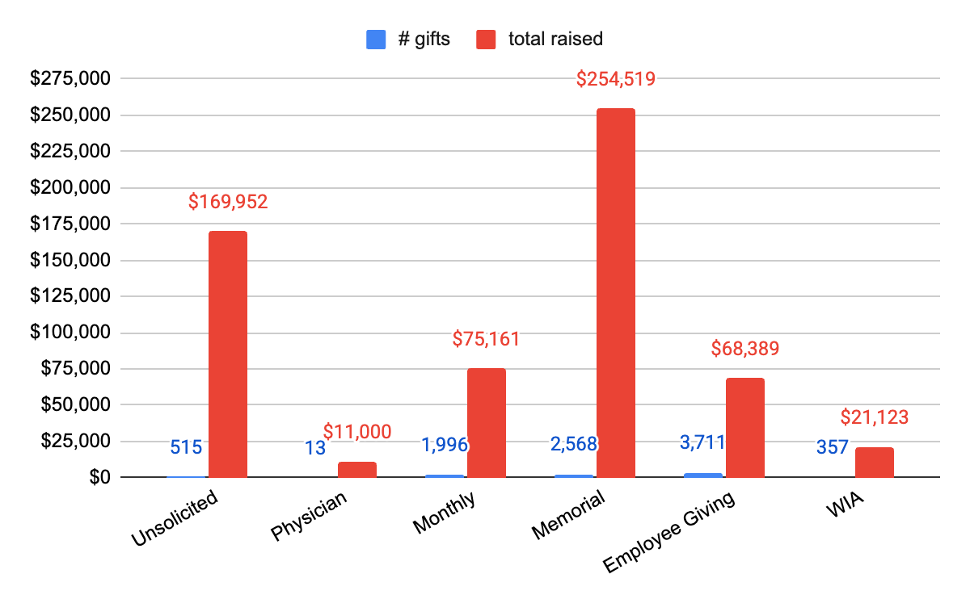
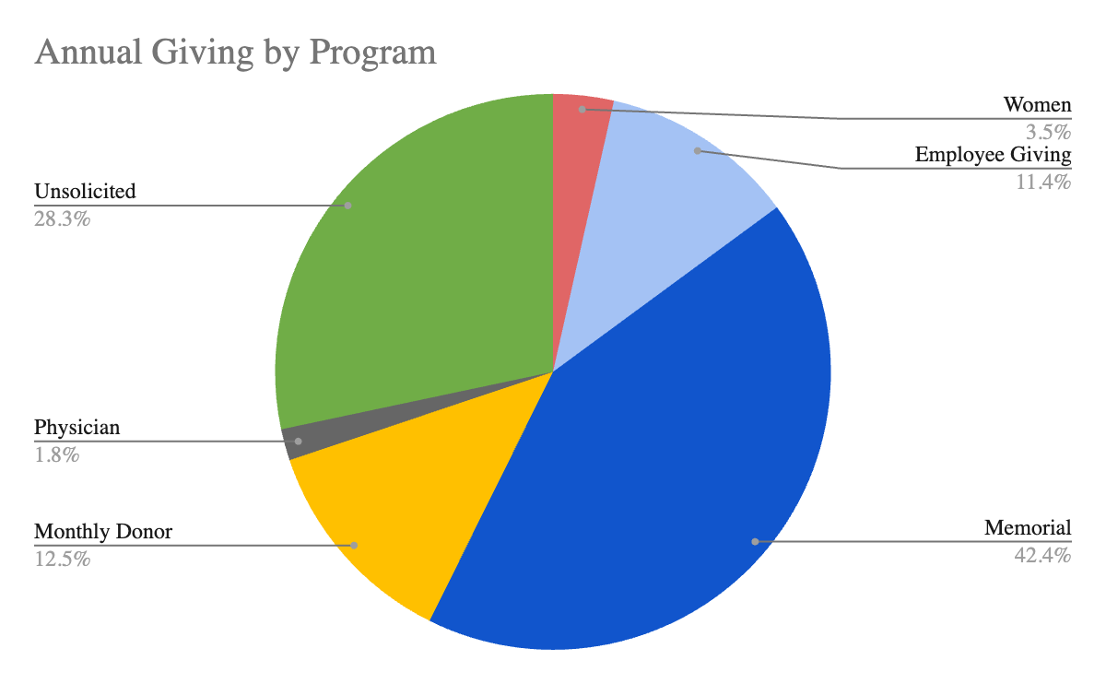
Annual Giving FY 2025-26
CONFIDENTIAL
GOAL $689,500
Total Gifts $690,070
% Goal 100.1%
# Donations 9,160
$ Gifts Received $616,570
# Online Donations 1,424
# Mailed in Donations 7,737
Q4 Highlights: -Direct Response proves to remain a strong program
-Memorial gifts account for 43% of annual giving program
-Increase in Employee Giving retention
-AG portfolio shared across Philanthropy and Engagement Directors
2026-27 Q1 Priorities: -Confirm DR schedule and appeal details (equipment)
-Use data to drive program decisions
Giving Tuesday 2025 GOAL $30,000 RAISED $73,500

Slide 6
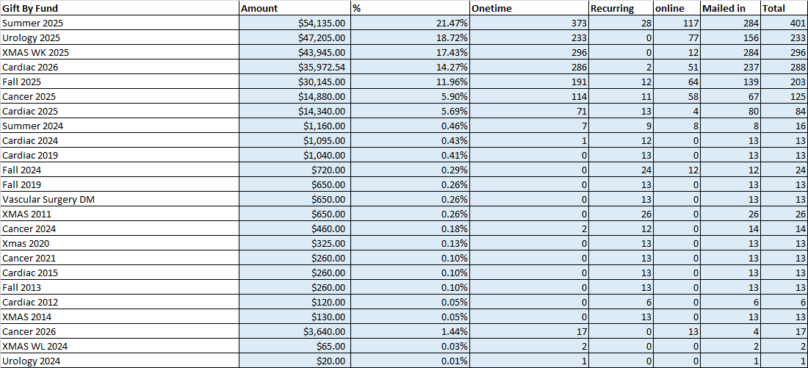
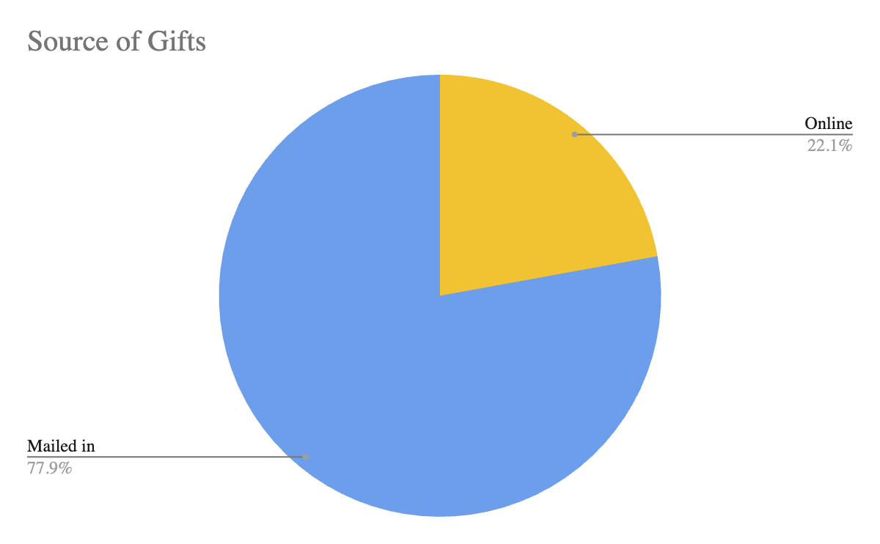
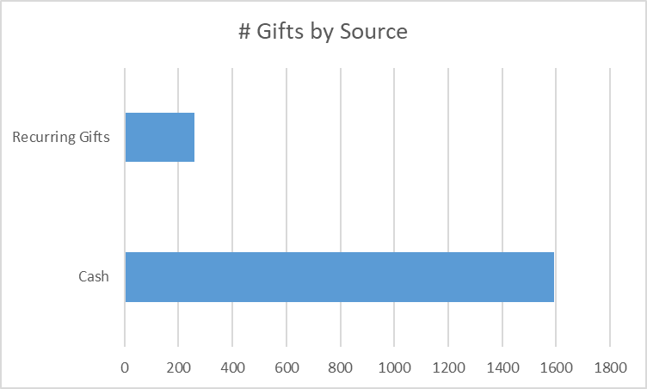
Direct Response FY 2025-26
CONFIDENTIAL
GOAL $345,000
Total Gifts $252,127
% Goal 73%
# Gifts Received 1,806
# Cash Gifts 1,561
# Recurring Gifts 245
Best performing appeal: Vision (Summer 2025)

